Slide 1
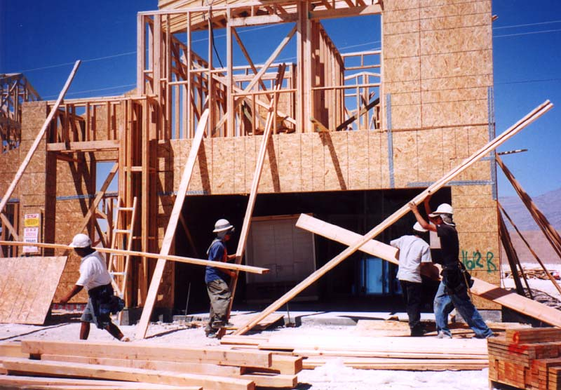
Making Houses More Appealing to Buyers
Final presentation
RAFAEL MOREIRA SILVEIRA
SPRINGBOARD – DATA SCIENCE CAREER TRACK

Slide 2
Problem statement
Should owners consider improving their houses before selling?
Goal 1: Prove that remodelled houses are significantly more expensive
Goal 2: Build a Machine Learning Model to support homeowners decisions

Slide 3
dataset
The dataset used for this study is the Ames Housing Dataset, which presents 79 explanatory variables describing several aspects of residential homes in Ames, Iowa, United States.
https://www.kaggle.com/c/house-prices-advanced-regression-techniques/overview
Once this study is finalized, with minor adjustments, the algorithms generated may be applied for different regions.
To treat this dataset, the following operations were necessary:
Checked for errors – mistyped information, for example
Cleaned or filled missing information
Checked for consistency among columns
Treated outliers
All those steps are detailed in the Data Wrangling Report.

Slide 4
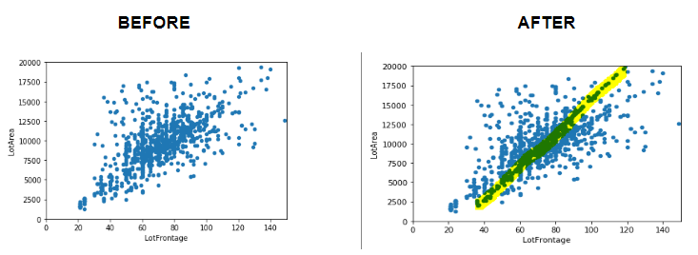
Findings - LotFrontage and LotArea
Association between variables LotFrontage and LotArea
We verified that this relationship exists and used it to fill missing values

Slide 5
findings - not so useful variables
Roof Style and Roof Material
Roof styles are predominantly "Gable" with material "standard Shingle". As we have very few observations of the other types of Roof and types of material, we cannot draw statistically relevant conclusions. As a result, this variable will not be among those we will suggest to be improved.
Pool Quality
Not enough houses with pool to draw significant conclusions. Improving the quality of the pool will not be suggested to owners.

Slide 6
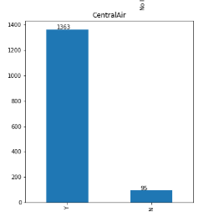
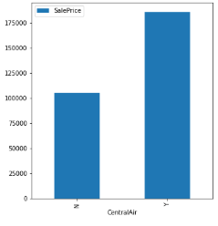
findings – Central air
Most have central air
Difference in price is significant
There are all types of houses WITH central air, meaning the seller will either make an improvement or sell it for way less. We notice an increment of $80,000 on average.

Slide 7
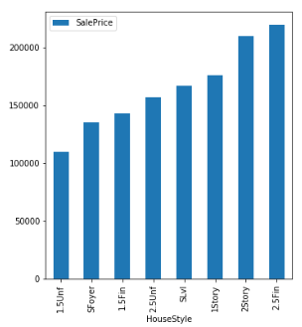
findings – number of stories
Surprise: 1 story house more expensive than a one and a half story (finished or unfinished) and more expensive than a two stories house with 2nd level unfinished.
EXPLANATION:
1.5 and 2 stories houses with 2nd level unfinished are located in "poor" neighborhoods
1.5 and 2 stories houses with 2nd level unfinished are older

Slide 8
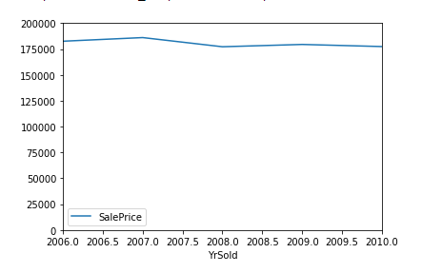
findings – Inflation?
No need to take inflation into consideration

Slide 9
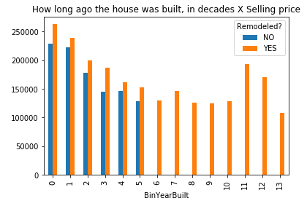
findings – Remodelled x non-remodelled (1/2)
Smallest difference
Remodelled houses are more expensive than non-remodelled houses, which is the cornerstone of our project.
Next slide: is this difference significant?

Slide 10
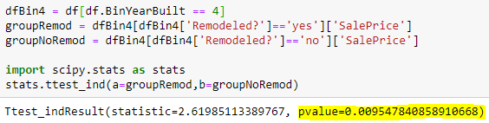
findings – Remodelled x non-remodelled (2/2)
Bin 4 (houses built between 40 to 49 years ago) shows the smallest difference.
Hypothesis test on bin 4:
H0: Mean(remodelled) – Mean(not-remodelled) = 0
H1: Mean(remodelled) – Mean(not-remodelled) > 0
We will estimate the mean and the standard deviation from the sample and use t-statistic.
Using python code,
P-Value less than 1%
REJECT H0
Remodelled houses are more expensive on average

Slide 11
Machine learning models
Kaggle uses RMSE (Root-Mean-Squared-Error) between log Predicted and log Observed.
Local score = R²
ID | Model Family | Description | Kaggle Score | Local Score
3 | LinearRegression() | - Column “LotFrontage” calculated with LinearRegression(); - Data not normalized | 0.19921 | 0.09799
4 | LassoCV() | CV = 3 Alpha = 100 | 0.15103 | 0.87345
7 | LinearSVC() | Default parameters | 0.40867
8 | ElasticNet() | -Pipeline with StandardScaler and GridSearchCV - L1_ratio = 0.74 | 0.15345 | 0.84387
13 | RandomForest() | - 'RF__max_depth': 8, - 'RF__n_estimators': 200 - GridSearchCV → cv = 5 | 0.25075 | 0.01027
15 | GradientBoosting() | - ‘grad__learning_rage’: 0.05 - ‘grad__n_estimators’: 1000 | 0.13327 | 0.90036
Kaggle Benchmark = 0.40890
Best model: GradientBoostingRegressor()

Slide 12
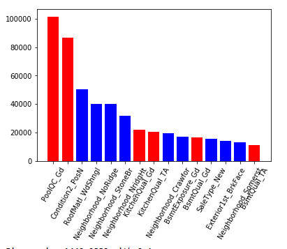
Exploring the best model (1 / 2) – Most relevant features

Slide 13
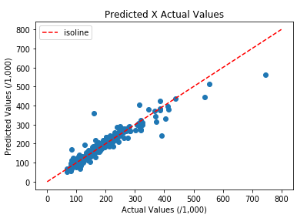
Exploring the best model (2 / 2) – Quality of predictions

Slide 14
Key takeaways
Houses that undergo home improvements tend to be sold for more.
Our Machine Learning model can successfully estimate the increase in the Selling Price due to a home improvement.
Home improvement service providers could greatly benefit from this project, by providing a list of services, the cost and potential increase in the selling price.

